Slide 1

SOA Performance Testing Challenges
First Presented for:
Software Test & Performance Conference
November 2006, Boston, MA
Scott Barber
Chief Technologist
PerfTestPlus, Inc.

Slide 2
Agenda
Overview
Evolution of Software Architecture
The Concept of SOA
SOA Testing Challenges (other than performance)
SOA Performance Testing Challenges
Common SOA Testing Challenges
Summary

Slide 3
Overview
The technologies, standards, applications and management of Services Oriented Architectures (SOA) are still in a significant state of flux.
Unfortunately, that doesn't stop folks from using it
or keep us from having to test it.

Slide 4
Overview
SOA is based on a variety of concepts that we, as an industry, have seen and tested before...
some for nearly a decade.
Luckily, this means that, as an industry, we have a lot of tried and true testing techniques at our disposal to apply to SOA projects.

Slide 5
Overview
Testing SOA applications is more complex than testing the majority of the applications many of us have become used to.
The up-side is that this complexity is likely to force us to test SOA applications in the ways we should have been testing applications all along.

Slide 6
Evolution of Software Architecture
Stand Alone
Client-Server
Distributed “n-tier”
Web Services
Service Oriented

Slide 7

Stand Alone Architecture
A tightly coupled collection of data and functions residing on a single machine.
Reuse, redesign, and replacement of component parts is often difficult.

Slide 8
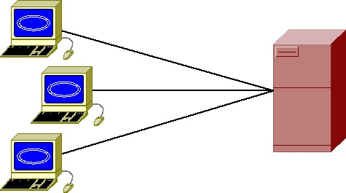
Client-Server Architecture
Similar to Stand Alone:
  A tightly coupled collection of data and functions residing on a single machine (server).
  Reuse, redesign, and replacement of component parts is often difficult.
Differs in allowing multiple users access to the application from remote machines (clients).

Slide 9
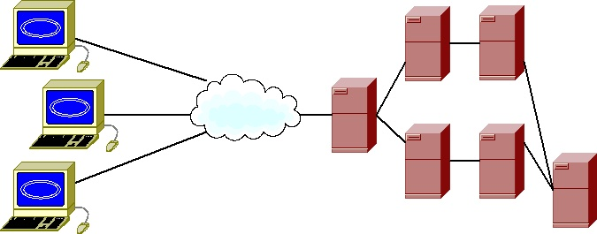
Distributed Architecture
A loosely or tightly coupled collections of data and function residing on multiple machines.
May be easier to reuse, redesign, and/or replace component parts.
Typically serves multiple remote users.

Slide 10
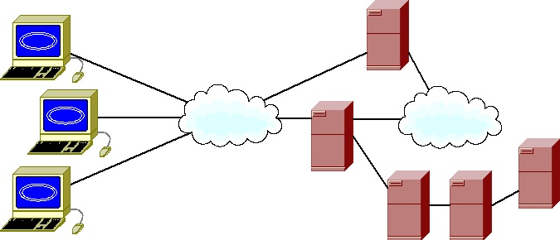
Web Services Architecture
A loosely or tightly coupled collection of data and functions residing on multiple machines.
One or more collections of data and/or functions are built and hosted externally.
May be easier to reuse, redesign, and/or replace component parts. (The web service is intended
to be “plug and play”.)
Typically serves multiple
remote users.

Slide 11
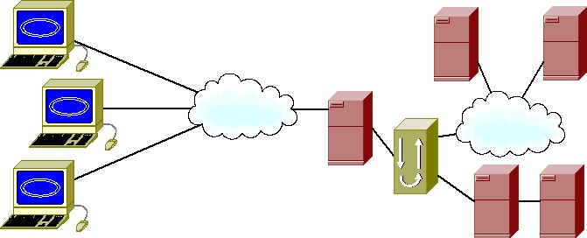
Service Oriented Architecture
A loosely coupled collection of data and functions residing on multiple internal or external machines.
Often, collections communicate through a single interface.
Reuse, redesign, and replacement of component parts is intended to be (relatively) easy.
Typically serves multiple remote users.

Slide 12
The Concept of SOA (General)
Service Oriented Architecture (SOA) is an approach to implementing business systems across a loosely coupled set of technologies.

Slide 13

The Concept of SOA (View 1)
SOA is “a way of designing and implementing enterprise applications that deals with the intercommunication of loosely coupled, coarse grained (business level), reusable artifacts (services) that are accessed through well-defined, platform independent interface contracts.”
- Steve Wilkes

Slide 14

The Concept of SOA (View 2)
“I've heard people say the nice thing about SOA is that it separates data from process, that it combines data and process, that it uses web standards, that it's independent of web standards, that it's asynchronous, that it's synchronous, that the synchronicity doesn't matter...
... I was on the SOA panel. I played it for laughs by asking if anyone else understood what on earth SOA was. Afterwards someone made the comment that this ambiguity was also something that happened with Object Orientation. There's some truth in that; there were (and are) some divergent views on what OO means. But there's far less Object Ambiguity than the there is Service Oriented Ambiguity…”
- Martin Fowler

Slide 15

SOA Application Design
This part everyone seems to agree on:
Business Level
Function
Function A
Function B
Function C
Component
(Service)
Function D
Function E
User Interface
Application A

Slide 16
The SOA Concept
In fact, these services can come from many sources and be distributed over heterogeneous environments.
Developed
3rd Party
Shared
Purchased
Purchased
Developed

Slide 17
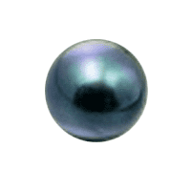


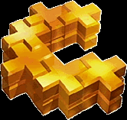

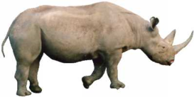
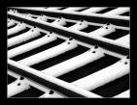
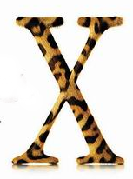





Innovations
The ambiguity Martin Fowler jokes about is the myriad of available choices in hardware, software, and process technologies.

Slide 18

Service Oriented Architecture
Testing Challenges

Slide 19
SOA Testing Challenges
Since SOA applications are composed of loosely coupled business-level services distributed over a network, we must test the application...
    end-to-end
    service-by-service
    and interface-by-interface

Slide 20
SOA Testing Challenges
Although we may not control the testing, we need to establish trust in SOA services in the following areas:
Functionality
  API (Application Programming Interface)
  Interoperability/Integration
Publish, Find, and Bind
Security
Performance

Slide 21
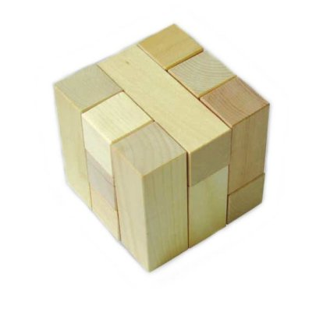
Functionality Testing Challenges
SOA architectures should make the application’s overall functionality easier to test.
However, this only works if we
or someone we trust
thoroughly tests the application’s
components (services) before
we assemble them to create
the application.
Starting with lower-defect components typically makes for a smoother testing process, BUT …

Slide 22
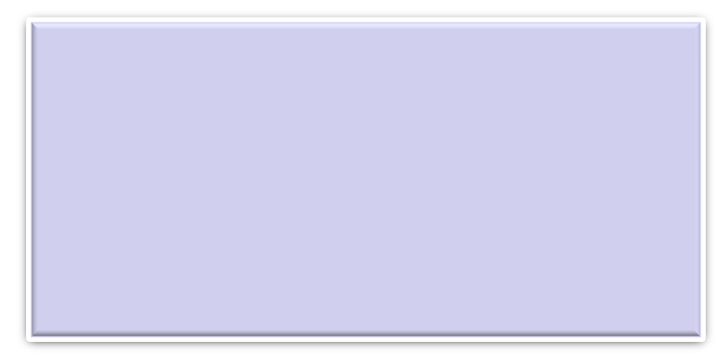
Functionality Testing Challenges
SOA applications tend to have more APIs, one for each service, and have communication paths between services.
This increases the amount of integration and interoperability testing that must be performed.
Who is responsible for this testing:
    The service provider?
    The service requester?
    Both?
    Someone else?
How do we establish trust?

Slide 23
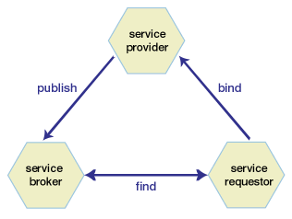
Publish, Find, and Bind Testing Challenges
Service providers must “advertise” their existence to brokers (automated catalogues).
Service requesters (SOA applications) must find providers and connect (bind) to them to use their services.
Service brokers must accept
registrations and then provide
information through search
functions.

Slide 24
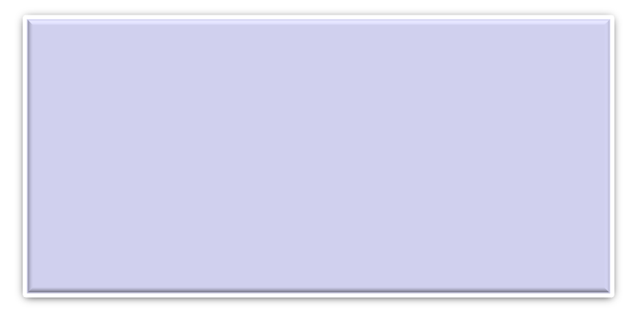
Publish, Find, and Bind Testing Challenges
You may not have tested anything like this before, unless you've tested 3rd party credit card processing for a web application.
Are the services your organization is providing able to properly register themselves?
Can your SOA application find and properly bind with services?
Who is responsible for this testing:
    The service provider?
    The service requester?
    Both?
    Someone else?
How do we establish trust?

Slide 25
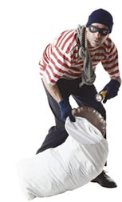
Security Testing Challenges
An SOA application is a collection of independent services collaborating to provide valuable functionality.
“Valuable” often suggests the need for
secure user authentication.
Consider an application in which each service required a different authentication approach and enforced different security policies – it would be design, development, and testing nightmare.

Slide 26
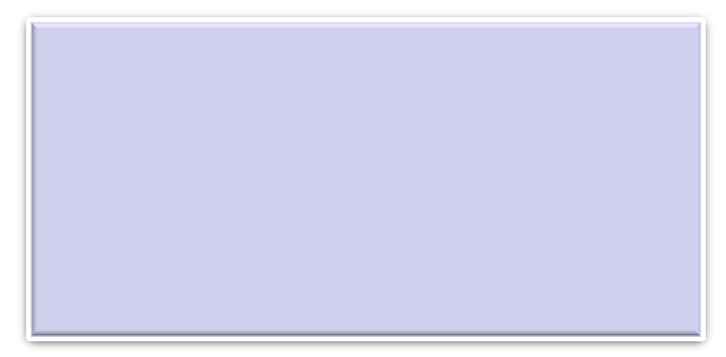
Security Testing Challenges
The security of your users’ data depends on a centralized SOA security management approach.
Various strategies include:
    Ignore the problem.
    Hide within a private network.
    Whip up a home-brewed solution.
    Buy this functionality from an experienced vendor.
Who is responsible for this testing:
    The service provider?
    The service requester?
    Both?
    Someone else?
How do we establish trust?

Slide 27
Performance Testing Challenges
All this loosely-coupled, platform-independent stuff is not free.
Major performance problems are often due to:
    Layer upon layer, abstraction upon abstraction
    Small services with large overhead
    Large services that are under-supported by hardware
    Services distributed across a network with its associated latency
One could also say...
“Performance is not synergistic.”

Slide 28
Performance Testing Challenges
The application will need to be performance tested:
    End-to-end, from the user's perspective (requester)
    At the unit level during development (provider)
    At the service level (likely both requester and provider)
    To validate each interface (likely both requester and provider)
    To ensure correct functionality under load

Slide 29
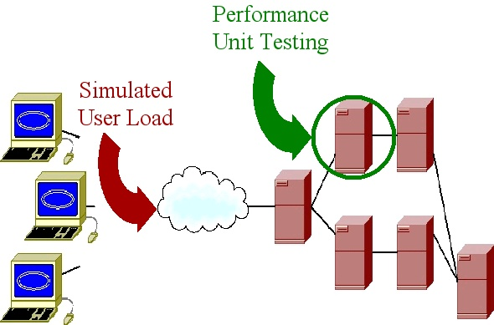
Performance Testing Challenges
What we’ve become accustomed to

Slide 30
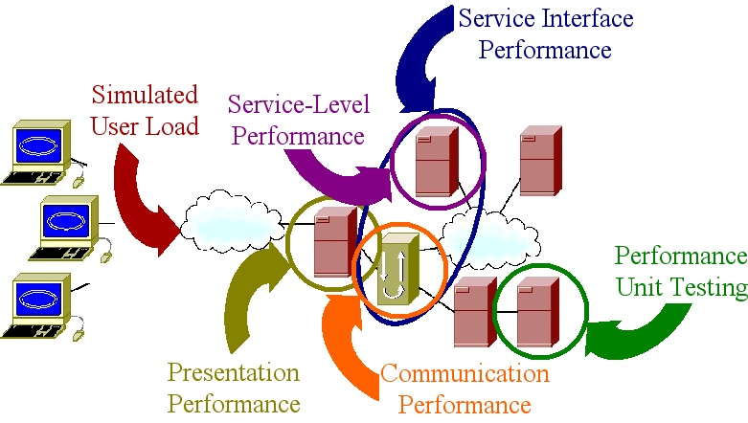
Performance Testing Challenges
What we should have been doing in the first place

Slide 31


Common SOA Testing Challenges
What is your degree of trust in… ?
Functionality
  APIs
  Integration/Interoperability
Publish, Find, and Bind
Security Or are you?
Performance

Slide 32

SOA Testing Challenges Overall
How well did your vendor test?
  How do you know?
How do we establish trust in a service?
How do we demonstrate that our SOA application is worthy of the trust of our users?
Who is responsible for this testing:
    The service provider?
    The service requester?
    Both?
    Someone else?
How do we establish trust?

Slide 33
Summary
SOA adds complexity, but very little that is really “new.”
Trust between providers and requesters is key.
SOA ought to force us to test the way we probably should be testing anyway.
Performance testing SOA forces us to think about what is and is not within our control.
Performance testing SOA requires an ability to decompose and recompose the system tier by tier.
Specialized tools may be helpful, but not unless we are analyzing the problem adequately.

Slide 34

Questions

Slide 35
Contact Info
Scott Barber
Chief Technology Officer
PerfTestPlus, Inc
E-mail:
sbarber@perftestplus.com
Web Site:
www.PerfTestPlus.com

